Slide 1
Improving SAT Participation Rates
Notes:
Hi my name is Lindsey Roeder and I’m a data scientist for the college board.
I’ll be speaking to you today about ways to improve SAT Participation across the country.

Slide 2
How can we increase the participation rate?
Promote and enhance free online learning to prepare for the test
Continue to make the test more accessible to all students
Focused state: Missouri
Gaining the confidence of school boards and students
Notes:
So how can we increase the participation rate?
We need to start with gaining the confidence of school boards and students
There are 2 ways to do this: help students better prepare for the test and make the test more accessible to everyone
Later in the presentation i’ll walk through reasoning on why Missouri is one state we should focus efforts on

Slide 3
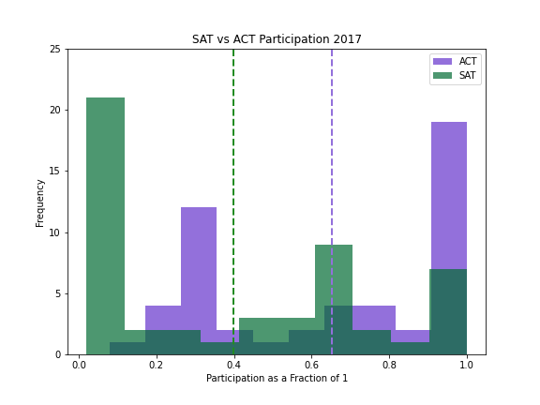
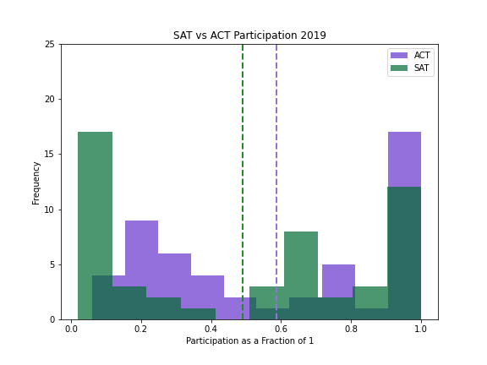
Progress Since Updating SAT in 2016
Notes:
Since we updated the test in 2016 the SAT’s participation has been improving
These histograms show the 2017 & 2019 distribution of ACT vs SAT participation
I’ve put both tests on top of the same graph in order to compare
In blocks of 10% intervals the bars show how many states fall into each bucket
For example, the first green bar on the left is telling us that the SAT had 17 states with 10% or less participation
Looking at the dotted vertical lines - these represent the average participation rate for each test
In 2017 the ACT was far ahead of the SAT and the gap between the averages was wide at 65% ACT vs 40% SAT
What the purple bar shows is 19 states had over 90% ACT participation
In contrast the green bar showing SAT had only 7 states in the same bucket
In 2019 we showed progress - the gap between the averages was 57% ACT vs now 50% SAT
ACT above 90% participation dropped to 17 states
And the SATs increased to 12 states

Slide 4
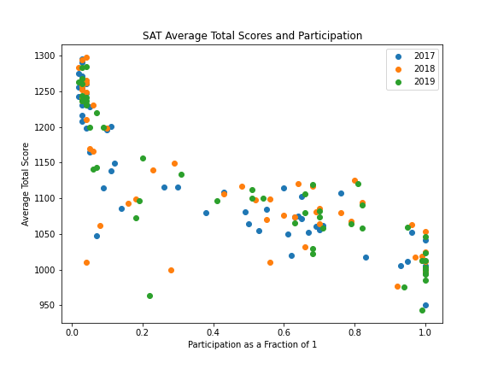
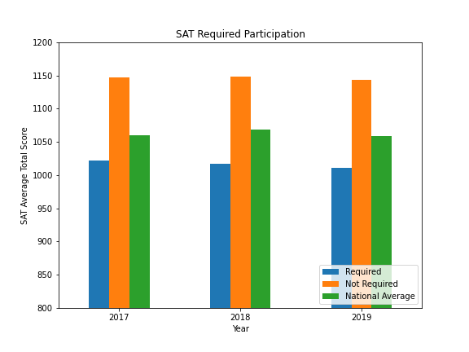
Inverse Correlation of Participation and Scores
https://reports.collegeboard.org/pdf/2017-total-group-sat-suite-assessments-annual-report.pdf
Notes:
One complaint of increasing testing participation is that average scores are lower in states with required SATs to graduate
This is seen with both SAT and ACT, it is not unique to our test
These graphs show the correlation
In the left plotted chart with each color representing a different year
The states with 5% or less participation mostly score over 1200
The states that require SATs mostly score under 1050
This is consistent across all three years of the study.
The bar graph on the right splits states with required SAT testing against those who do not require it
Here i took out any state that switched their rules between the years of the study to normalize the data
It’s clear that required testing scores in blue are consistently below the national average shown in green
Not required testing shown in orange is consistently above the average
For this slide I pulled the national average of all students from the college board’s annual reports.

Slide 5
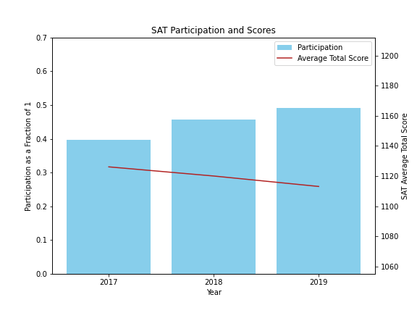
Effect of SAT Participation on Scoring
Participation increased from 40% to 50%
Averages scores decreased 13 points
Notes:
This chart dives into the inverse correlation between participation and total test scores
The blue line offers a look into the steady increase in SAT participation between 2017 - 2019
Whereas the red line represents a combined total score from each state’s individual average
While average scores didn’t decrease at an alarming rate, we should address the concerns and come up with a plan to fix the problem

Slide 6
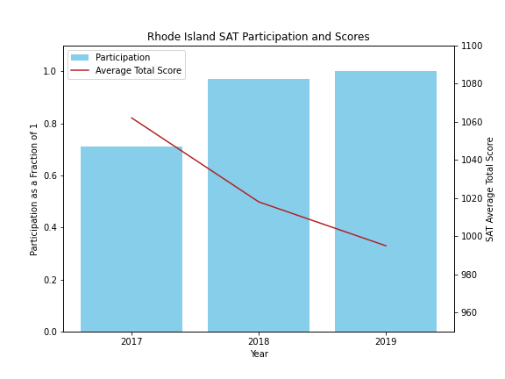
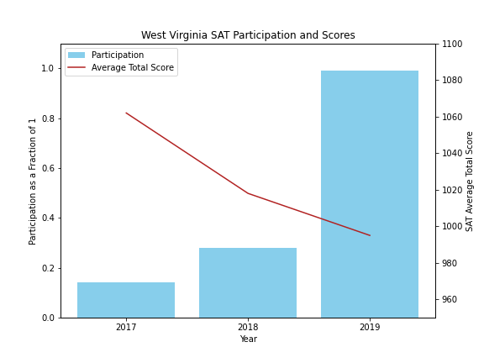
Individual States - RI & WV
6.3% Decline in Average Scores
13.2% Decline in Average Scores
Notes:
Looking at individual states is important in order to show the impact of requiring tests
Rhode Island and West Virginia offer us a unique view into how requiring SATs affect scores
Both changed their statewide rules between 2017 - 2019
In those three years Rhode Island saw a 6.3% decrease and West Virginia saw a 13.2% decrease
When we have mandatory testing there will be students who do not have the proper drive or resources to prepare
One way to maintain high scores while keeping high participation is through our partnership with Khan Academy

Slide 7
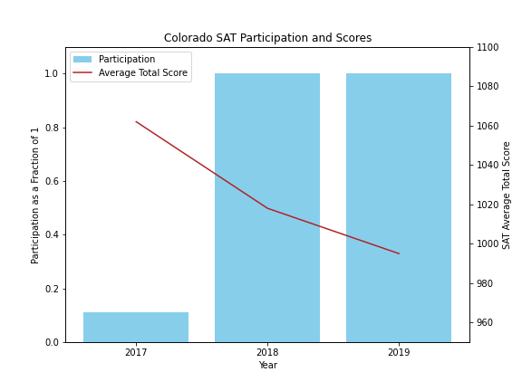
How to improve scores?
Colorado
Switched from ACT to SAT in 2018
Participation was 11% in 2017
Increase spending on providing free test prep
https://www.coloradokids.org/wp-content/uploads/2016/01/ACTvsSAT_FINAL.pdf
Notes:
This was an important selling point for Colorado, which is another state that switched to requiring full participation.
This is an interesting case because it required the ACT in 2017.
Part of their reasoning for switching was the test prep.
I pulled the following quote from their original memo announcing the switch from ACT to SAT.
“In March 2015, College Board partnered with Khan Academy to provide free, personalized test prep for any student with computer access, saving students and families at least $300 and leveling the playing field for families that might not be able to afford test prep or tutors for their children.”
This quote provides us with an important message that we need to be taking advantage of the good publicity and advertise our program with Khan Academy
I recommend continued funding to constantly improve the test prep because it’s clearly important to our stakeholders

Slide 8
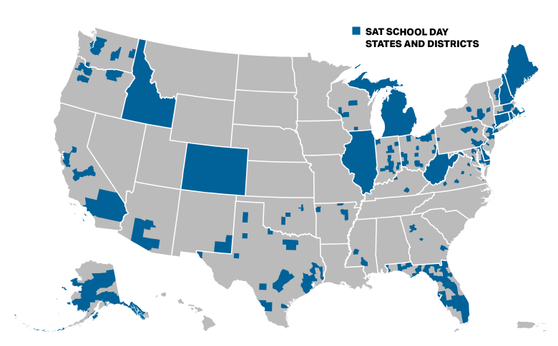
SAT School Day
Free Benefits Included:
Retaking the SAT
Send scores to colleges
Apply to eligible colleges
Apply for financial aid
SAT School Day graph: https://reports.collegeboard.org/archive/sat-suite-program-results/2018/sat-school-day
Notes:
In addition to our free tutoring program we should be promoting SAT school day to students
Helping schools fund and organize an SAT day would greatly increase the number of students able to participate
For those who aren’t familiar with the program - SAT school day provides students with the opportunity to take the test for free at their school during a regular school day
This solves a lot of problems such as not being able to afford the test or not having transportation to a testing location
The map shown here, pulled from the college board website, is representative of where this benefit was offered in 2018, shown in blue
10 states plus Washington DC, along with many districts in other states, took part in this awesome opportunity
10 states and DC (Colorado, Connecticut, Delaware, Idaho, Illinois, Maine, Michigan, New Hampshire, Rhode Island, and West Virginia)

Slide 9
Next State to Focus On: Missouri
 | Colorado | Missouri
2017 SAT Participation | 11% | 3%
2017 SAT Avg Score | 1201 | 1271
2017 ACT Participation | 100% | 100%
2017 ACT Avg Score | 20.8 | 20.4
State Population | 5.7 M | 6.1 M
Reasoning:
Low SAT Participation
3 - 4%
High SAT scores
Large population
https://simple.wikipedia.org/wiki/List_of_U.S._states_by_population
Notes:
While we ultimately want to increase country-wide engagement, focusing our efforts on one state at a time is a good idea
If Colorado was able to make the change, other states can follow.
Compared to Colorado, Missouri would be an even better state to go for next
There is a lot of room to grow in this state - participation has consistently been very low
ACT has typically been required in Missouri
The state also has high SAT scores compared to other states that require ACT only
It’s possible that regular schooling coursework is relevant to SAT topics in order to achieve such good results
It’s also a state with a large population that could hopefully swing other states

Slide 10
Conclusion
Put resources into providing free test prep
SAT School Day in more states and counties
Direct efforts toward large states with low participation
Missouri
Notes:
In conclusion I recommend two main strategies and one state to start with
First, continue to offer, evaluate, and improve free online SAT prep
Second, make SAT Day more widespread
Do this by providing funding and organization efforts
And finally, advertise to Missouri next to improve our participation there
Thank you for your time and I'm happy to answer any questions.

